Slide 1




Agile QA Practices
A course from
ThoughtWorks Studios

Slide 2

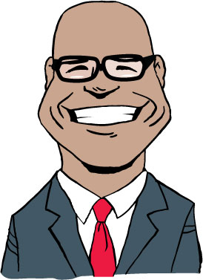
Introductions
Kevin McHugh
kmchugh@thoughtworks.com
Rohit Maurya
rmaurya@thoughtworks.com
Notes:
Who are you?
What do you do?
Two truths and a lie (I work in GE,I am a tester,I am from the moon)
Most inspiring movie and why?
Favourite Holiday destination?
What do you want to get out of the Agile QA course? (“I want to know how we can build a world-class Agile testing process”)
What concerns you may have about the training (“Three days is a small amount of time, can we really do anything successful in this time?”)
Three words that describe you

Slide 3
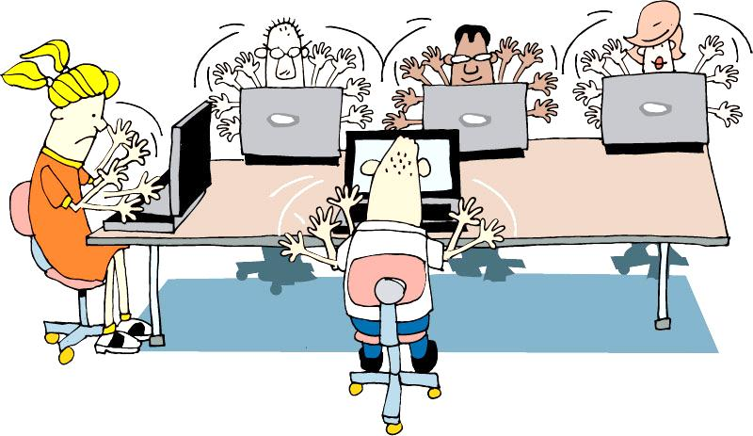
Team agreements
Take phone calls outside team room
Laptops down unless doing team work
Questions as we go or in parking lot
Break when needed
Be on time
Work in pairs
Notes:
We will try our best to answer any questions as the sessions progress.
Any questions which can’t be answered during the course of a session will go in the parking lot , we will take those at opportune moments.
Participate fully in all exercises. Try to complete all tasks to the best of your ability.
Ask for assistance. No one’s perfect, and it’s expected that you’ll ask for all necessary explanations.
No sleeping.
One discussion at a time.
We have scheduled break times, but you can agree with your pair to take other breaks as needed

Slide 4


Why are we here?
Concerns
Hopes
Notes:
Hopes and Concerns allows the trainers to understand what participants are expecting and what they might be concerned about.
We guide the participants to think about the workshop, but comments typically spill over to the Agile Adoption in the organization.
Prepare a flip chart with 2 sides. One for Hopes and one for Concerns.
Ask participants to write one thought per post-it. You may want to have 2 different color of post-its. 1 for the Hopes and another for the Concerns.
Give the participants about 5 minutes to write their items. Note if writing is slowing down, move to the next step.
Ask if anyone would want to share an item.
Have them read it and bring it to the flip chart.
Ask if anyone has anything similar. You are starting to build an affinity diagram but putting like items together on the flip chart.
Continue until all participants have shared their items.
Discuss the patterns/grouping of items.
Note any items that may be out of scope for the workshop.

Slide 5
Course “project” plan
Day 1 | Day 2 | Day 3
Introduction Review and overview Project inception Write stories Assessing quality and progress High-level testing strategy with team Release plan | Initiation/Iteration 0 “Done” for stories, iterations Get familiar with technology Plan for iteration 1 Iteration 1 How and why we automate Acceptance-test-driven development | Iteration 1 (continued) Iteration 2 Learn automation practices and patterns Learn and do exploratory testing Wrapup Parking lot review Retrospective

Slide 6
What you will learn
How agile QA and testing differs from other approaches
How to develop an agile test strategy
How to write valuable user stories and acceptance criteria
Testing practices that work well in agile projects
How to automate tests

Slide 7
To start…
Find a partner, so we have some mix of experience – we call this pairing
Take an index card – write “What We Know” on top
You have 5 minutes for this
Notes:
Have the most experienced and less experience pair, second most/second less, etc. until all paired
They can sit down, or continue standing for this exercise

Slide 8
How much agile knowledge?
Highly Knowledgeable
No knowledge
Notes:
Arrange yourselves around the room
Experts on one side, those with no agile knowledge on the other
Arrange yourselves in approximate order of your knowledge of agile
We call this self-organizing

Slide 9
Notes:
Remember the values stated by the 17 individuals at that ski resort in Utah.
Comprehensive documentation – we’ll discuss some of the artifacts that may be produced. Just enough.
Requirements are not contracts – they are initiations of conversations.
The plan we create will change. So we do just enough analysis to understand the concepts and know what we don’t know.

Slide 10
Agile project lifecycle
Initiation
Evolve/Hand over…
Inception
Develop and deliver
Notes:
There is planning – Inception
2 – 4 weeks for a 4 – 6 month project
Flows, scenarios, stories
We need to prepare for Development – Initiation
Environment(s) set up
Narrative writing
Team processes
Develop & Deploy
Release working software
About 12 weeks of work
Common question?? How do I know how big the project is to determine how much time for Inception?
There has been a ‘Conceptualizing’ phase hopefully.
Experience. Relative sizing to other projects you’ve done.

Slide 11
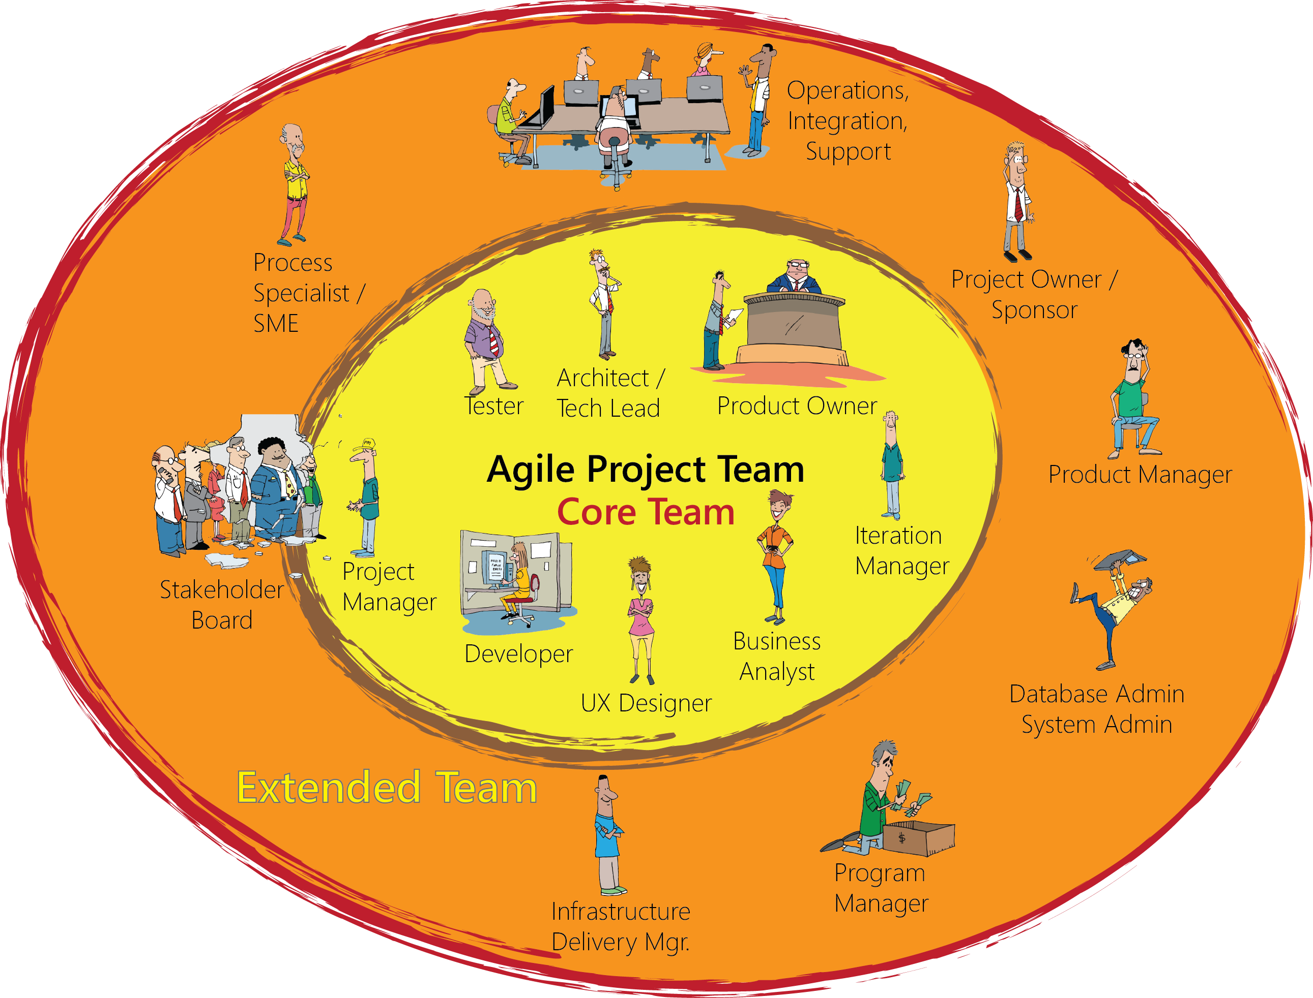

Team Composition
Notes:
Finally, the coach, who is effectively outside of it all, looking in and helping the extended team to avoid pitfalls and figure out how to reach high performance and achieve success.

Slide 12
Team activities by role
Analysis
Exploratory Testing
Test automating
Programming
Business Analyst
Process improvement
Quality Assurance
Experience Design
Programmer
User Experience Designer
Notes:
QA interacts with everyone and is vital
Who would QA pair with and in what activities?

Slide 13
Agile practices
Automated
Build/Deploy
Iteration kickoff/ planning meeting
Short
Releases
Pair
Programming
Showcases
Refactoring
Retrospectives
Automated
Testing
Collective
Ownership
Card Wall
Simple Design
Daily
Stand-ups
Velocity
Metrics
Test Driven
Development
Coding
Standards
Iterations
Co-location
User
Stories
INDIVIDUAL
Sustainable
Pace
Continuous
Integration
TEAM
On-site
Customer
ORGANIZATIONAL
Notes:
There are a variety of Agile practices (and some principles hiding in this slide too!) that can be applied at different levels of scope
Individual
Team
Organizational

Slide 14
Practices that benefit the QA
Unit testing
Continuous integration
Pairing and whole-team approach
Iterative development
Team co-location and shared space
Daily standups
Automated functional testing
Notes:
There are a number of Agile development practices that directly impact the quality of the code that is developed and the impact that testers can have on quality

Slide 15
The agile QA manifesto
How would you pair these like the agile manifesto?
Testing for risk
Scripted manual testing
Detecting defects
Gatekeeping
Preventing defects
Automated and exploratory testing
Informing
Testing for coverage
Notes:
Defect prevention over Defect detection
Automated testing over Manual testing
Testing for risk over testing for coverage
Informing over Gatekeeping

Slide 16
The agile QA manifesto
Through this work we have come to value:
That is, while there is value in the items on the right, we value the items on the left more.
Preventing defects
Detecting defects
Automated and exploratory testing
Scripted manual testing
Testing for risk
Testing for coverage
Informing
Gatekeeping
Notes:
Defect prevention over Defect detection
Automated testing over Manual testing
Testing for risk over testing for coverage
Informing over Gatekeeping
***
INFORMING
Includes providing an objective fact-based descriptive understanding of quality, not judgment. From James Bach’s blog (http://www.satisfice.com/blog/archives/605):
Bottom line is this: They both criticize the product pretty strongly, but Miagi-Do insulted the developer as well. That’s the spectacular wipeout.
...
The reason why Miagi-Do was the goat, while Springaby was the pet, is that Springaby did not impose their own standard of quality onto the product. They did not make a quality judgment. They made descriptive statements about the product. Calling it unstable, for instance, is not to say it’s a bad product.
And I think that is a good takeaway for any tester. There is no benefit to being combative in your findings - all you do is annoy developers/designers and introduce tension into teams. Spouting lines like "Like a race car leaking oil" and "this level of testing is not worthy of our effort" make the team (Miagi-Do) look petty and unwilling to work together.
The other team (Springaby) spent time with the developer to learn the expected level of quality in the product, to learn where they should focus their efforts and how it had been previously performing (as he was also acting as the end user). This level of 'research' is a valuable exercise as you not only pick up an deeper understanding of the product but you also build a rapport with developers. You can achieve this through pairing but you can also just grab a developer and chat. The scoring approach counted Developer Relations in this game but that's kind of how it works on projects too. Collaboration = win.

Slide 17
How do the Agile values relate to QA?
Simplicity, Feedback, Courage, Respect and Communication
Notes:
Divide into groups of three-four and discuss
Share your answers

Slide 18
Crispin and Gregory’s tester’s bill of rights
You have the right to:
Ask questions of customers and programmers and receive timely answers
Bring up issues related to quality and process at any time
Ask for and receive help from anyone on the project team, including programmers, managers, and customers
The tools you need to do your job in a timely manner
Notes:
Discussion time……
Are these rights representative of how you work as a tester today?
Do you get access to the customer(s) or their proxies to ask questions?
Can you ask the developers for help in testing parts of the application?
Do you feel you have good tool support in the testing you do, or are you aware of considerably more effective tools you could use if they were available to you?
[CLICK]
Do you have the ability to suggest or challenge requirements. Should you?

Slide 19
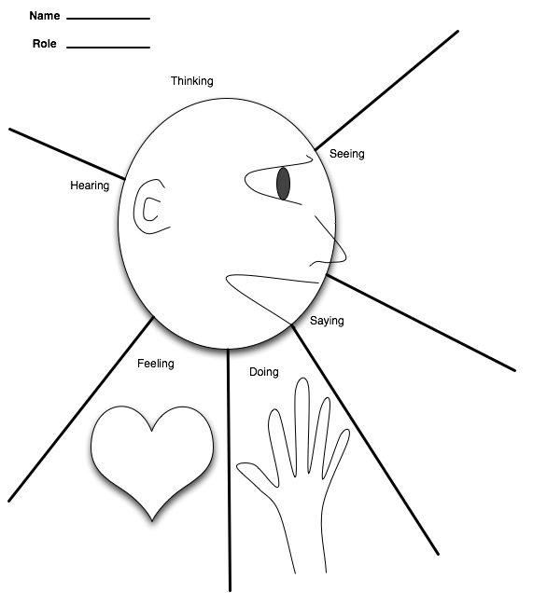
Empathy mapping
What’s work like now?

Slide 20



Slide 21
Inception
Phase 1 of an agile project
Initiation
Evolve/Hand over…
Inception
Develop and deliver

Slide 22
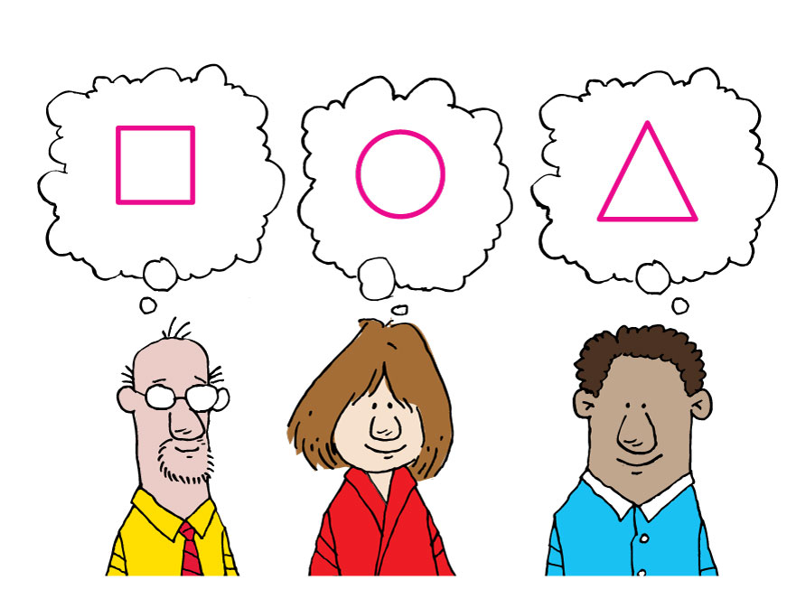
Communication is not always Clear
“I’m glad we’re all agreed then.”
Notes:
Problem of folks all thinking they are in agreement to what the problem is,
what the vision is,
what the solution looks like, etc.
IT has a different vision than the business,
different business units have different ideas of the problem, solution.

Slide 23
A Shared Understanding
Why are we doing this project?
Decision making around scope
Prioritization of features
The right solution
Notes:
How do we get to a shared understanding?

Slide 24
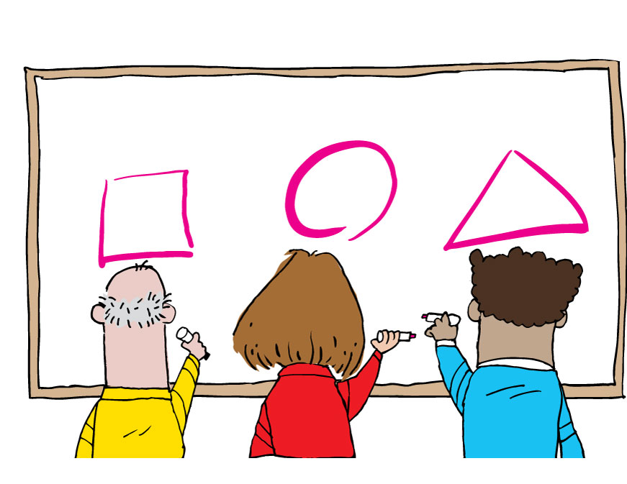
Mental Models
“Ah...”
Notes:
Use workshops & models throughout the project to
-----------------------------------------------------------------------------------
Then discuss that without models there is risk that folks are not on the same page. And that models are used throughout the project. Visioning, objectives, requirements gathering, process definition, etc. Models come in all forms.

Slide 25
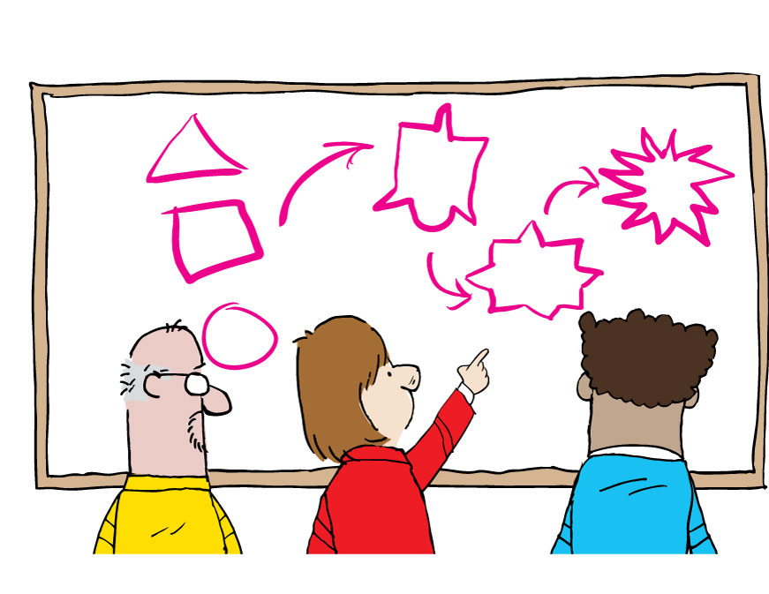
Convergence
“Ah!”
Notes:
An explicit model allows convergence through iteration
Through techniques we can converge the models to get to a common understanding

Slide 26
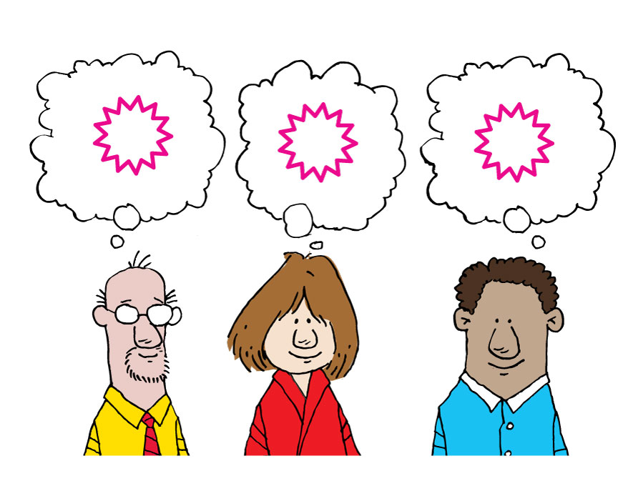
Shared understanding
“I’m glad we’re all agreed then.”

Slide 27
Goals of inception
Goal | What QA does
Understand the problem and business context | Help translate business needs into stories
Develop a shared understanding of the scope | Help determine how team will assess quality and progress
Define a candidate architecture | Develop high-level testing strategy with team
Develop a credible plan | Help team create release plan
Build relationships | Be involved with team early and often
Notes:
From Inception course

Slide 28
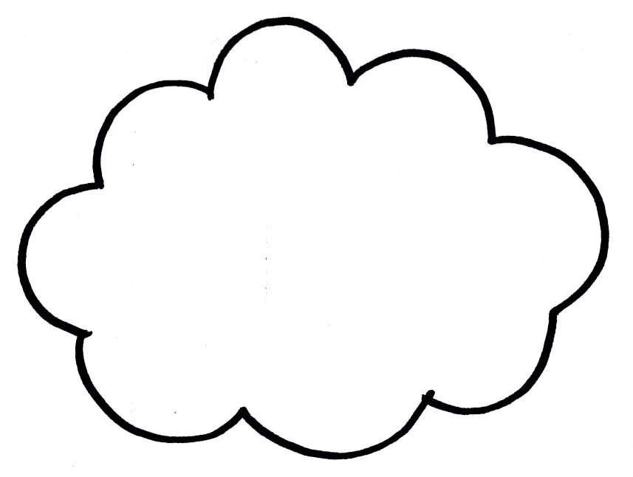

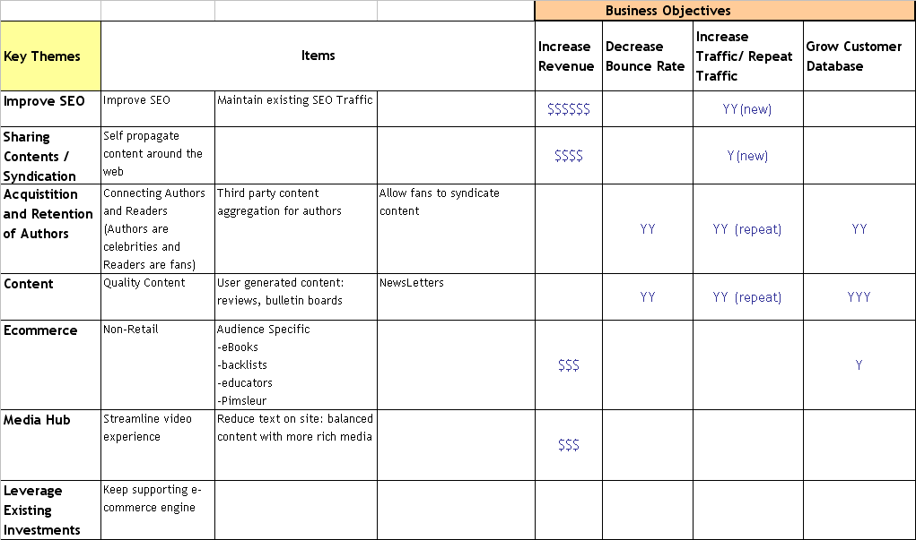

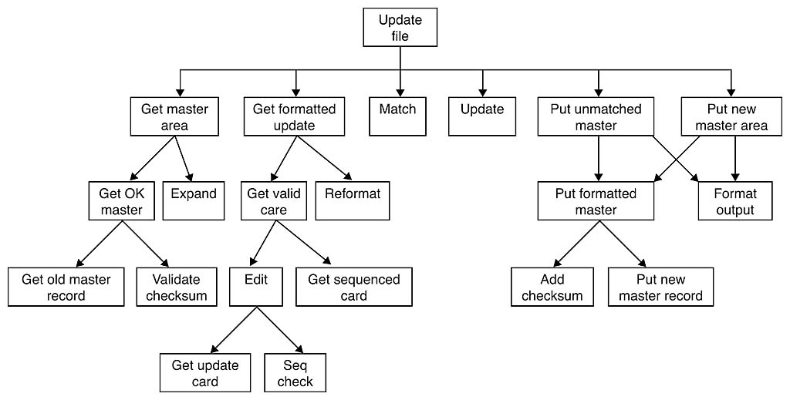
Roadmap
50,000 ft
25,000 ft
10,000 ft
5,000 ft
1,000 ft
500 ft
100 ft
Business
Objectives
Product-In-A-Box
User Roles
& Persona
Development
Customer
Journey
Sketch-board
User Story
Development
Technical
Vision
Draft Release
Plan

Slide 29
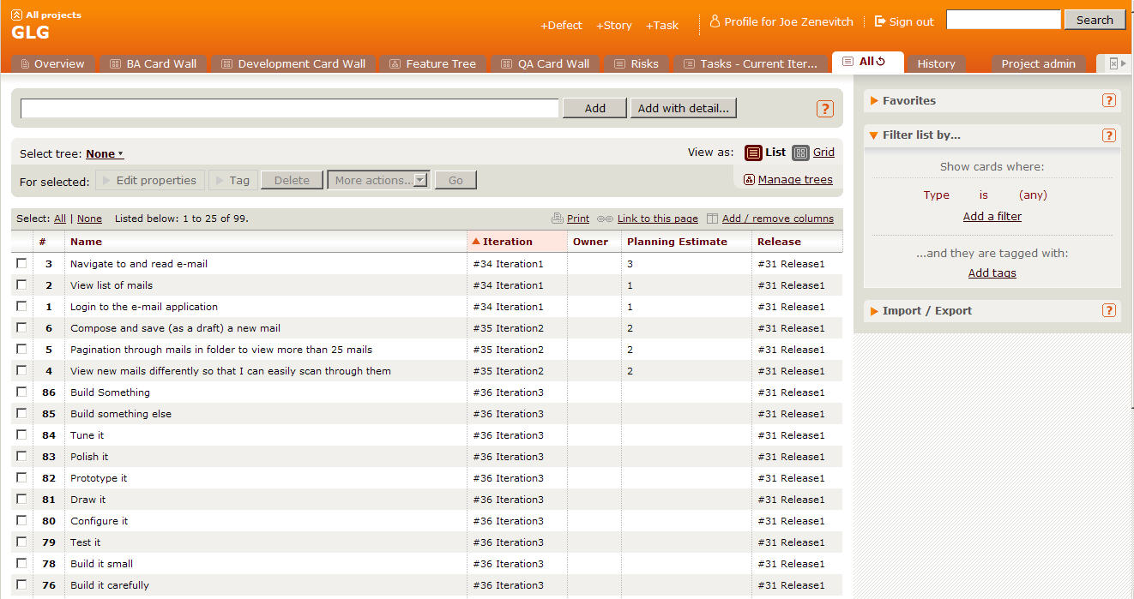
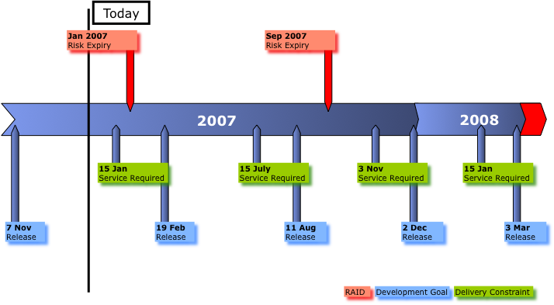
Deliverables – The Plan
Initial Story List
Release Plan
Notes:
Project approach
Stakeholder agreement
Prioritized Master Story List - A list of all the stories intended for the project. The stories need to be prioritized at least for the Release 1 functionality. High level prioritization can be done for future Release functionality.
Release Plan - What feature sets are scheduled to be delivered and when. This information is at a feature set or Epic level.
Staffing Plan - How many developers (pairs), BAs, QA, and other support staff will you need to get this work done in the required time frame?
Costs -You should have a good idea of staffing model, amount of work and then can calculate cost.
RAIDs
Inception deck / Project Charter - You likely have more information and knowledge that could change the original cost / benefit analysis.
Sponsor showcase
Low: 1 min
High: 3 min

Slide 30
The project
Market opportunity: to create the best online movie rental company offering the largest range of movies and TV shows delivered as DVD or Blu-ray by mail, or streamed instantly on-demand to a rapidly expanding range of connected devices.

Slide 31
Product features
Rent Digital Media (Stream/Download)
Rent DVD or Blu-ray by mail
Create & Maintain a Queue
Rate & Review
Subscription Plan & Tracking
Suggestions & Recommendations
Media Catalogue
Introducing TV Series (Digital Rental Only)
Promotion Feature

Slide 32
Create Master story list
Inception task 1

Slide 33
User Stories
Three C’s
Card
Conversation
Confirmation
Notes:
User Stories are:
The currency of Agile Development
A placeholder for further conversation
http://xprogramming.com/articles/expcardconversationconfirmation/ READ THIS
Good stories follow the INVEST Principle:
http://xp123.com/xplor/xp0308/ READ THIS
Independent
Negotiable
Valuable
Estimable
Small
Testable

Slide 34
Review: Story structure
As a Librarian, I want to be able to search for books by publication year so that I can produce a chronological index
As a <role>
I want to <goal>
So that <rationale>

Slide 35
Rethinking the role of Agile QA
Traditional Tester Role | Agile QA Role
Is part of separate test team | Is part of the entire team
Testing happens at end of development | Testing happens parallel to development
Works alone | Pairs with BAs, programmers and others
Acts as gatekeeper | Highlights risk
Has no or little contact with business | Has direct contact with business
Tests written and automated after development | Tests are written and automated before and during development
Notes:
Lets look at every point closely and understand its benefits in detail.
The fundamental goal of a tester is the same on all projects regardless of methodology
“We are a service organization whose job is to reduce damaging uncertainty about the perceived state of the product” Brian Marick
The role of a tester on an Agile project is more interactive than on waterfall projects
Testers work closely with developers to ensure fast feedback of issues
Testers work closely with business to understand where the value lies in the software being delivered
Testers work closely with project management to highlight risk and communicate quality issues

Slide 36
Motivation behind agile testing
Tests provide the safety net that lets agile projects proceed at a rapid pace.
Commitment to testing is reflected by the creation of large automated suites and vigilance for any changes that lead to test failures.

Slide 37
Testing strategy
Initially defined during project inception
Light-weight and non-prescriptive
Outline basic test process
Types of testing and responsibilities
List environment and resource requirements
List dependencies
Highlight risks and issues
Strategy can and should change throughout a project

Slide 38
Building a testing pyramid
How much?
What should we automate vs. leave manual?
Which tools?
When in the development cycle?
Who does the automation?
What mix of testing makes sense?
End-to-end tests
System tests
Functional tests
Component/integration tests
Unit tests
Notes:
Answers important strategic questions:
How can tests be executed early and often enough to mitigate risk?
How can tests be maintained as long-lived, evolving, and reusable assets?
How can testing involve all the stakeholders in the software development process such that requirements are fully understood and tested?
How can the highest value most essential testing be identified?
Functional test automation is not an end unto itself – it’s a tool and a capability
Automation does a few things very well:
Makes regressions run faster, freeing testers up to think, not click
Allows for running tests in different environments and on different platforms
Shores up the safety net
Extends your capacity to cover different testing models
Gives fast feedback to teams
Reduces the defects that make it to production by providing frequent regression checks
Makes requirements clearer by giving developers executable acceptance tests
Automation does not:
Find all of the bugs a user might encounter
Find logical inconsistencies, performance, security or UX problems in the application
Cover all boundary conditions, particularly at higher levels
Brittleness
Maintainability
Time Required
Not inherently collaborative
In order to ensure the quality of your application, it is important to build up good test coverage with different types of testing
In order to ensure the quality of your application it is important to build up good test coverage at each of the levels below
Unit tests
Ensure good code quality
Acceptance tests
Ensure that the functionality is implemented correctly
Automated functional tests
Ensure functionality does not regress
Exploratory tests
Used to track down difficult conceptualise test cases
End to end integration tests
Ensure the system works as a whole
Non Functional tests
Ensure that system meets non functional requirements such as performance and security

Slide 39
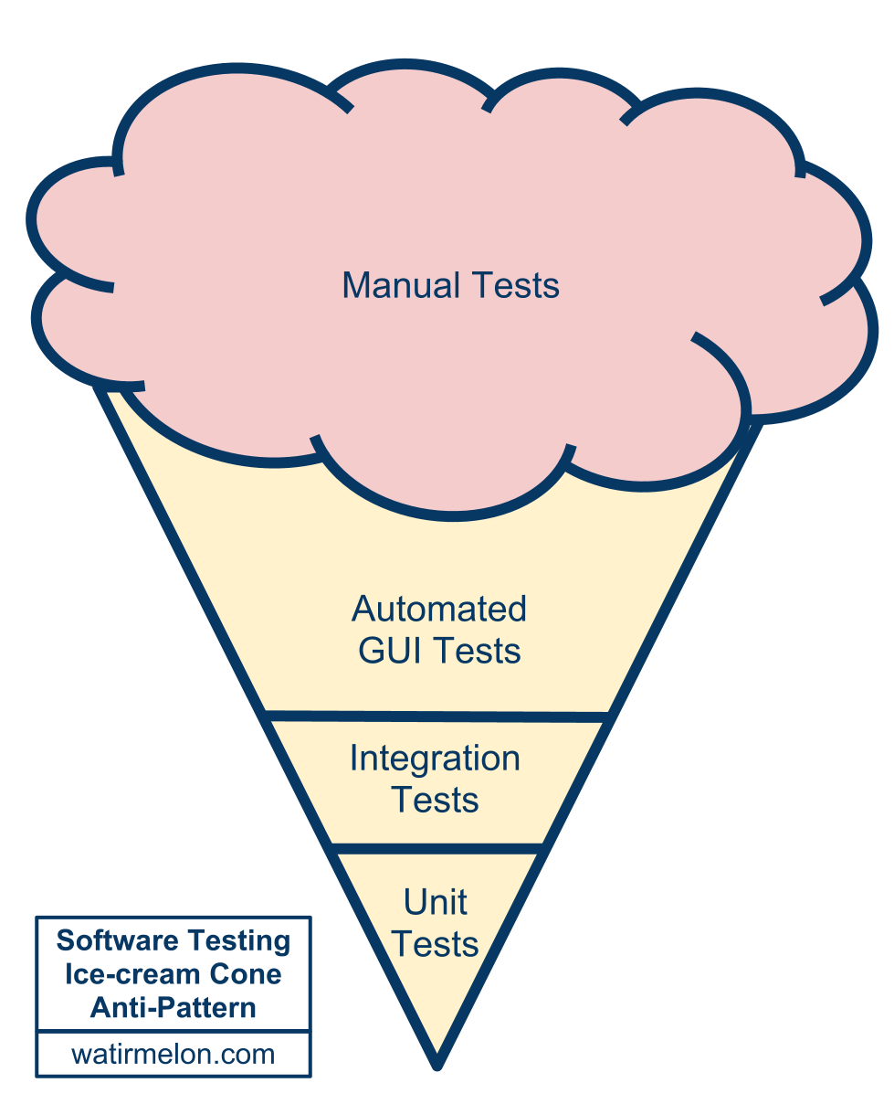
Alister Scott’s testing anti-pattern
Notes:
Alister is a ThoughtWorker in Brisbane, Australia.

Slide 40
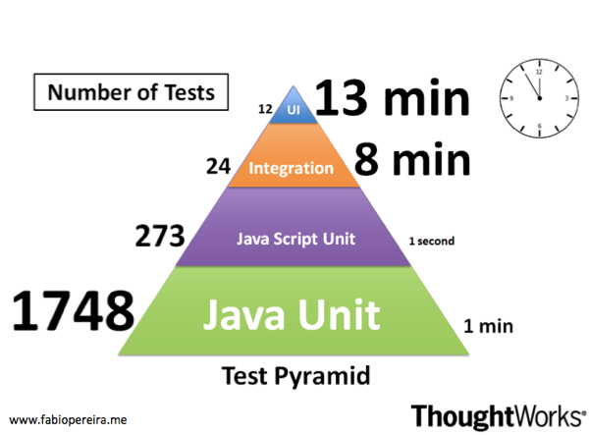
Testing pyramid: Example
Notes:
Test automation is prevalent in the software development community. Practices like TDD and BDD are widespread and applied almost unquestionably. However, several organisations have struggled in attempting to scale automated test suites, which very often become slow, brittle, non-deterministic, unreliable and difficult to maintain.
One common issue reported by many teams and that I have also experienced many times is the inverted testing pyramid.
A year ago I joined a project that was going in that direction. I could see us making the same mistakes again. If we had kept going we would have ended up with the slow and hard to maintain, melting ice-cream cone. However, this time we tried a different approach. Our strategy was to test the code as close as possible to where it was written using preferably either unit or integration tests. We only automated high level test journeys at the UI level.
Now, one year later, we have a stable and fast build, which gives us an extremely high level of confidence.
Some observations:
Only 12 tests through the UI take 13 minutes to run
1748 unit tests take only 1 minute
273 JavaScript unit tests take less than 1 second. Treating JS as a 1st class language helped us as well

Slide 41
Where would you test this?
Build your own test pyramid
Notes:
Split up into teams of 3
Each group takes a couple of stories
Think about the entire testing effort for each story
Plot those tests on a pyramid
Then we’ll discuss

Slide 42
Where would you test this?
Test | Where? | How?
Environment is set up
Tax is computed properly
COTS rule engine is configured
“date of birth” control element works
Layout of UI is correct
Capacity (performance)
Javascript that shows updated number of tickets remaining
Bulk upload of tickets into new bug tracker (batch process)
Possible data change in production
Service is responding

Slide 43
Where would you test this?
How much?
What should we automate vs. leave manual?
Which tools?
When in the development cycle?
Who does the automation?
What mix of testing makes sense?
End to end tests
System tests
Functional tests
Component/integration tests
Unit tests
Notes:
Answers important strategic questions:
How can tests be executed early and often enough to mitigate risk?
How can tests be maintained as long-lived, evolving, and reusable assets?
How can testing involve all the stakeholders in the software development process such that requirements are fully understood and tested?
How can the highest value most essential testing be identified?
Functional test automation is not an end unto itself – it’s a tool and a capability
Automation does a few things very well:
Makes regressions run faster, freeing testers up to think, not click
Allows for running tests in different environments and on different platforms
Shores up the safety net
Extends your capacity to cover different testing models
Gives fast feedback to teams
Reduces the defects that make it to production by providing frequent regression checks
Makes requirements clearer by giving developers executable acceptance tests
Automation does not:
Find all of the bugs a user might encounter
Find logical inconsistencies, performance, security or UX problems in the application
Cover all boundary conditions, particularly at higher levels
Brittleness
Maintainability
Time Required
Not inherently collaborative
In order to ensure the quality of your application, it is important to build up good test coverage with different types of testing
In order to ensure the quality of your application it is important to build up good test coverage at each of the levels below
Unit tests
Ensure good code quality
Acceptance tests
Ensure that the functionality is implemented correctly
Automated functional tests
Ensure functionality does not regress
Exploratory tests
Used to track down difficult conceptualise test cases
End to end integration tests
Ensure the system works as a whole
Non Functional tests
Ensure that system meets non functional requirements such as performance and security

Slide 44
Agile testing practices
Just-in-time test strategy
Test early: move it forward in cycle
Automated testing
Acceptance test driven development
Manual testing becomes exploratory testing
“Rightweight” testing
Notes:
Techniques used to develop test cases are the same when testing within Agile projects; the difference is when and how you execute those test cases
“Right-Weight” means structuring your test artifacts in a way that is supportive of frequent iterations & feedback
Apply a level of detail to your test specification that is good enough for the type of testing, don’t over specify! It slows you down.

Slide 45
Testing Practices: Test early
Story card reviews
Acceptance tests
Functional tests
System integration tests
Performance
Security
Notes:
Successful testing on Agile projects relies on testing as early as possible for all aspects of the project
Story card reviews Testers can review story cards and use their skills in a similar way as they would apply Static Testing techniques to testing requirements documents within a waterfall or V model project
Acceptance tests When testers work together with Business Analyst to define acceptance tests for a story it creates a fuller understanding of the functionality required and helps drive out potential defects early
Functional tests By testing a piece of functionality as soon as it has been developed in makes fixing any defects quicker and cheaper
System integration tests By testing integration between systems early in a project you can reduce the risk of late chances to the system that can occur when integration bugs are found late in a project
Non Functional tests Understanding non functional requirements such as performance and testing that these requirements can be met early on in an applications development reduces the risk of late changes

Slide 46
High-level Test strategy
Inception task 2
Notes:
Who what when where and how
Divide into small groups

Slide 47
determine how team will assess quality and progress
Inception task 3

Slide 48
Principles of agile metrics
Foster transparency, honesty and trust
Means to the end of improvement
Use to compare team to itself and not to others
Use “for a season” to address specific problems
“Of the team, by the team, for the team”
Measure team, not individuals
Big and visible
Low cost
Notes:
Use for a season means that they should be considered temporary

Slide 49
Questions to ask
Questions to ask | Example areas to track
What is the quality of our product? What is the quality of our process? What is our progress? How good is our testing? What is our truck/lottery number? Where are most of our defects appearing? Are we going too fast? Slow? Where are our bottlenecks | Build performance (time, too many red builds, long-running builds) Stories rejected at showcase Burndown/burnup line Code coverage Pairing habits Velocity consistency Needless interruptions (non-story work) Cumulative flow, Cycle time Work in progress Defects in production Running tested features
Notes:
Shore’s examples:
Amount of pairing, by tracking the percentage of time spent pairing versus the percentage of time spent flying solo
Pair switching, by tracking how many of the possible pairing combinations actually paired during each iteration (see Figure)
Build performance, by tracking the number of tests executed per second (see Figure)
Support responsiveness, by tracking the age of the oldest support request (an early chart, which tracked the number of outstanding requests, resulted in hard requests being ignored)
Needless interruptions, by tracking the number of hours spent on non-story work each iteration
Others:
Coupling/Cohesion of interfaces as a mechanism for showing well-designed modules which can be reused
Number of dependencies (Java)
Right first time

Slide 50
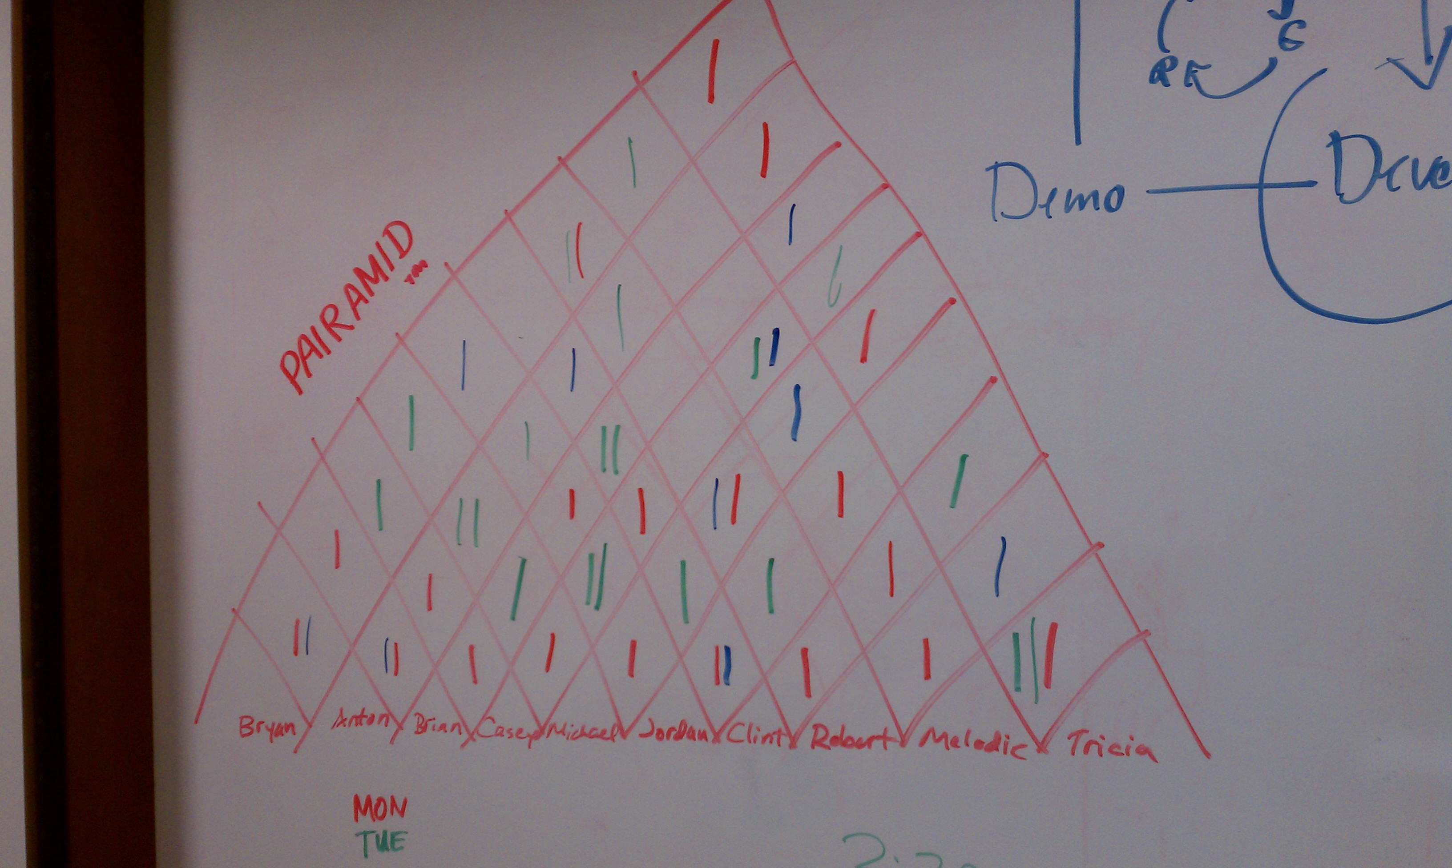
Pairamid/Pairing chart
Notes:
Start with a reasonably well-defined task before you sit down
Agree on one tiny goal at a time
Rely on your partner, support your partner
Talk a lot!
Sync up frequently
Take a moment to celebrate as you complete tasks and overcome problems
Switch roles often—at least every half hour
Infrastructure:
One Monitor
Both Pairs are looking at the same location
Smaller Desktop
Two Monitors – Mirrored
Pairs not looking at the same location
Smaller Desktop
Conversations don’t come as easily
Two Monitors – Spanned
Both Pairs are looking at the same location
One Huge Desktop
Enables more non-verbal communication
One Shared
Encourages Communication
Must either express yourself or ask for the keyboard
Two (One for each person)
Faster to take control
Less physical movement
Less germ spreading!
Egg Timer / Chess Clock
Encourages rotation of roles within a pair
Driver swapping
Pair Stair/Pairamid
Encourages working with everybody
STYLES
Driver & Navigator
Driver works tactically, Navigator works strategically
Easiest to start with
Roles should be swapped as frequently as possible
Ping pong
'A' writes a test, 'B' makes it green.
Next 'B' writes the test, 'A' makes it green
A mix of Pairing and Test Driven Development (TDD)
Ball and board
Advanced pairing technique
One person controls the mouse (The Ball)
The other person controls the keyboard (The Board)
Useful for forcing yourself to learn keyboard shortcuts
You either learn them, or have to ask the Ball to do things for you

Slide 51
Make your own metric
What kind of behavior do we want to encourage?
Notes:
Divide into groups of 4-5
Based on Alexandre Boutin’s “Behavior Driven Metrics”
Come up with:
Name of metric
Description of its purpose
Positive behaviors that it encourages
Negative behaviors
Ways it can be gamed
Gaming
While having too many process improvement charts can reduce their impact, a bigger problem occurs when the team has too much interest in a chart, that is, in improving a number on a chart. They often start gaming the process. Gaming occurs when people try to improve a number at the expense of overall progress.
For example, if programmers focus on too much on improving the number of tests in the system, they might be reluctant to remove out-of-date tests, making maintenance more difficult, or they might add unnecessary or redundant tests. They may not even realize they're doing so.

Slide 52
Defects
Stories within iteration don’t have defects but are merely done or not done
Defect fixing is not a parallel stream of work, but part of the main development backlog
Defects are treated like stories (prioritized and have acceptance criteria).

Slide 53


